Slide 1
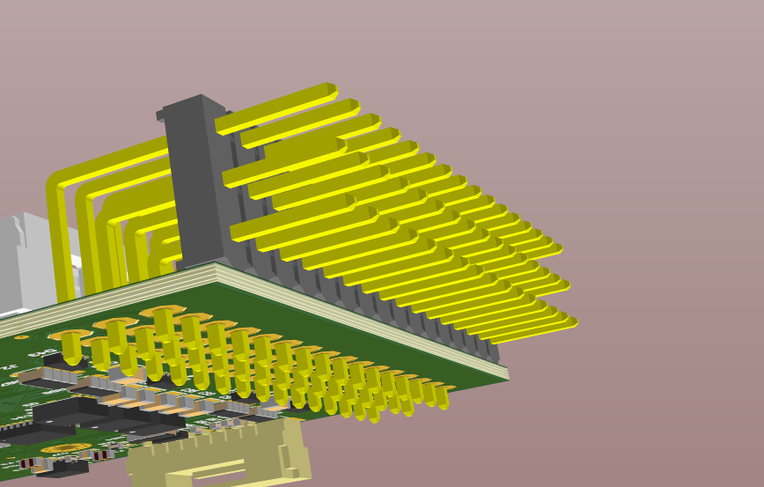
Top Mounted Connector
Sky
- : Row A
+ : Row B
S : Row C
Earth
Pin 1

Slide 2
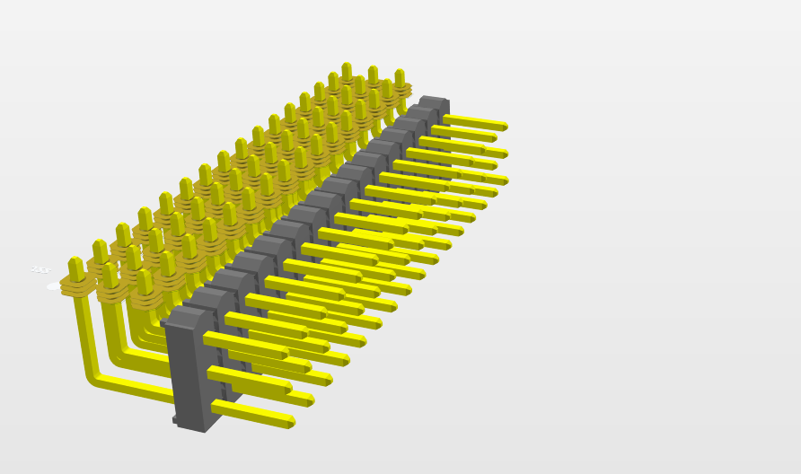
Bottom Mounted Connector
- : Row C
Pin 1
+ : Row B
S : Row A

